Slide 1
Legal and Policy Topics, Part 1
Expanded CRIT Content

Slide 2
Legal and Policy Topics
Part 1: Federal and State Law
Part 2: Agency Policies and Procedures
Part 3: Legal Considerations in Practice

Slide 3
Module Overview – Part 1
The Legal Landscape
Defining Disability
U.S. Constitution
Disability Rights Laws
State Commitment Laws
Strategies for Avoiding Liability
Key Takeaways

Slide 4
Which Law Wins
U.S.
Constitution
Federal Laws
State Laws
Agency Policies and Procedures

Slide 5
Defining Disability
Under the Americans with Disabilities Act (ADA), a person has a disability when they:
Have a physical or mental impairment that substantially limits one or more major life activities.
Have a record of such impairment.
Are regarded as having such an impairment.

Slide 6
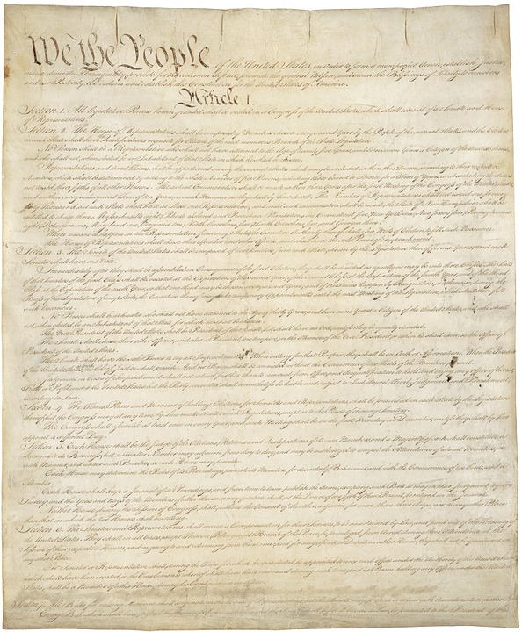
U.S. Constitution
Unreasonable stops/arrests
Use of force
Equal protection
“Color of law”

Slide 7
Disability Rights Laws
Title II of Americans with Disabilities Act (ADA): Requires officers to make reasonable accommodations for people with disabilities
Olmstead v. L.C. – Case law
Section 504 of the Rehabilitation Act
Apply to everything officers do:
Stops
Searches
Arrests
Transports

Slide 8
Rights and Responsibilities
People with disabilities (or perceived disabilities) have rights.
Officers have the responsibility to ensure these rights are protected.
If an officer fails to meet that responsibility, this can lead to discrimination.

Slide 9
Potential Types of Disability Discrimination
Overt/intentional discrimination/deliberate indifference
Wrongful arrest for disability-related behavior
Failure to ensure effective communication
Failure to reasonably modify practices, policies, and procedures
Disparate impact

Slide 10
Example 1: Intentional Discrimination/ Deliberate Indifference
Purposely treating a person differently because of their disability, leading to harm.
Example: An officer who grew up with a brother with an opioid addiction is assigned to an overnight shift patrolling a downtown area where people who use drugs are known to congregate. Every night she sees a group of men in front of a liquor store; one of them always seems "high." After a week on patrol, she arrests the man, not because he was doing anything wrong, but because she thinks he needs treatment. She does not arrest any of the other men in the group.

Slide 11
Example 2: Wrongful Arrest
Perceiving disability-related behaviors and characteristics as criminal.
Example: An officer on patrol observes a young man in a park. The man is repeatedly bringing a piece of string to his face. The officer stops and asks the young man what he’s doing. The man replies that he’s "stimming." The officer believes the man is referring to drug use and tries to take the young man into custody. A family member intervenes and tells the officer the young man has autism, but the officer proceeds to make the arrest.

Slide 12
Example 3: Failure to Ensure Effective Communication
Not ensuring that communication is as effective as communication with those without disabilities.
Example: A mother calls police to report that her autistic son is "tearing up the house." The son is nonverbal and prefers to type messages on his phone to communicate. When the police arrive, the mother is cleaning up broken dishes while her son is sitting on the couch playing a video game. The police handcuff the son and do not let him use his phone to answer their questions.

Slide 13
Example 4: Failure to Provide Reasonable Modifications
Modifying policies, practices, and procedures when necessary to avoid discrimination.
Example: An officer takes two young people into custody after witnessing them breaking a store window. After asking a few questions, the officer suspects that one of them may have an intellectual disability. The officer doesn’t change how he gives the person the Miranda warning. The person keeps repeating that they don’t understand the information but signs the form anyway.

Slide 14
Example 5: Disparate Impact
A policy or procedure that appears neutral on its face, yet disproportionately impacts individuals with disabilities.
Example: A police department analyzes its policies, practices, and procedures for interactions with people with serious mental illness (SMI). It determines that people with SMI make up 5% of the population in the jurisdiction, but people with SMI make up 25% of persons arrested by police officers.

Slide 15
What Type of Discrimination?
Officer arrests someone on suspicion of intoxication, but the person is not intoxicated. They have a disability that affects their movement and speech.
Officer speaks to a person’s family member instead of the person with a disability directly, because the person uses their iPad to communicate.
During booking, officer takes a cane from an individual who needs that assistive device, following the agency’s standard operating procedure.

Slide 16
State Laws
State Disability Rights Laws
State Commitment Laws

Slide 17
State Disability Rights Laws
[insert your state’s disability rights laws that are relevant for law enforcement]

Slide 18
Civil Involuntary Commitment Law

Slide 19
Commitment as a Last Resort
The civil commitment law is a LAST RESORT for resolution of a mental health crisis.
Using the least restrictive alternatives, when possible, is less invasive, protects the individual’s rights, and increases the possibility of successful outcomes.

Slide 20
Alternatives to Using the Civil Involuntary Commitment Law
Other crisis response resources – mobile crisis teams, crisis lines
Community resources – case management, outpatient services, peer support
Consult with family and friends for resources
Voluntary admission
Other state statutes for substance use, IDD, dementia

Slide 21
Voluntary Admission Process
Who can apply for voluntary admission
Adults
Parent/guardian of minors
Role of law enforcement to take someone voluntarily to hospital or crisis center
Agency policy and procedure related to transportation
Paperwork required by law enforcement if transporting someone voluntarily to a hospital or crisis center

Slide 22
Assessment Considerations for Mental Health Condition Indicators
Verbal indicators
What the person is saying and how they are saying it
Behavioral indicators
Observation of abnormal behavior
Body language
Environmental indicators
Observation about the person’s environment that may indicate a mental health condition or another condition
No one indicator by itself meets the legal element of the law (totality of circumstances)
Q&A

Slide 23
Individual Rights
[placeholder for local presenter’s slides regarding clients’ rights for involuntary and voluntary hospital admission]

Slide 24
Confidentiality and Privacy
There are a variety of federal and state statutes and case law governing confidentiality.
Unless the person, guardian, guardian advocate, or surrogate/proxy waives by express and informed consent, confidentiality shall be upheld.
Officers are generally not bound by confidentiality laws.
Can share information with providers and family members.
Family members can provide information to the mental health provider, even if the mental health provider cannot release information or discuss the person’s treatment without express and informed consent.

Slide 25
Civil Involuntary Commitment Law
[placeholder for local presenter’s slides regarding state and local laws for civil involuntary commitment]

Slide 26
Who Initiates?
Who can initiate an involuntary commitment process according to state law?

Slide 27
Report Writing
[placeholder for local presenter’s slides regarding report writing – fill in with the form or categories in a report that the officer will complete]

Slide 28
Transportation and Other Law Enforcement Requirements/Considerations
[placeholder for local presenter’s slides according to statute, policy, and/or contract agreements between agencies]

Slide 29
Civil Involuntary Commitment Process
[placeholder for local presenter’s slides of a brief outline of the process from the time an officer drops the person off for an evaluation to discharge, including due process considerations and individual rights]

Slide 30
Important Reminders
The civil involuntary commitment law can be used by officers to take a person into custody for a mental health evaluation.
It should be used as a last resort.
Officers should explore less restrictive interventions appropriate to the person’s needs.
Including de-escalation and/or engagement with community resources to resolve on-scene.
When in doubt, seek guidance from a supervisor.

Slide 31
Officer Liability
Assault and battery
False arrest
Intentional infliction of emotional distress

Slide 32
Strategies for Avoiding Liability
Assume disability.
Ensure effective communication and make reasonable modifications.
De-escalation
Seek guidance from a person’s family/friends and/or community resources.
Consult a supervisor for assistance.
Document, document, document.
Become familiar with local disability resources.

Slide 33
Key Takeaways
There are a variety of laws that affect interactions with individuals experiencing a crisis.
Many people experiencing a crisis qualify as a person with a disability.
Officers have responsibilities to ensure a person’s rights are protected and to avoid discrimination on the basis of disability.
Civil commitment is a last-resort option and should only be used if there are no less restrictive alternatives appropriate to the person’s needs.
When in doubt, seek guidance from a supervisor.
There are many strategies to help an officer avoid potential liability, including de-escalation and documentation.

Slide 34
Practical Tips
Assume disability.
Don’t discriminate, de-escalate.
Prioritize safety for all.
Utilize community resources/try to resolve on scene.
Document, document, document.
QUICK TIPS

Slide 35
Module Wrap-Up
Questions?
This curriculum was created through support by Grant No. 2020-NT-BX-K001 awarded by the Bureau of Justice Assistance. The Bureau of Justice Assistance is a component of the Department of Justice’s Office of Justice Programs, which also includes the Bureau of Justice Statistics, the National Institute of Justice, the Office of Juvenile Justice and Delinquency Prevention, the Office for Victims of Crime, and the SMART Office. Points of view or opinions in this document are those of the authors and do not necessarily reflect the official positions or policies of the U.S. Department of Justice.

